Slide 1



Project Guide LY COMPS
Mr. Gopal Sonune AY 24-25
LY Project
Web Application Firewall Using
Machine Learning
16010121057 - Om Ghadia
16010121060 - Aaryan Golatkar
16010121064 - Manas Hardikar
16010121068 - Sai Jadhav

Slide 2
Index
Sr No. | Title | Page No.
1 | Introduction | 3
2 | Literature Survey | 4
3 | Problem Statement | 5
4 | Project Scope and Objective | 6
5 | System Design | 7
6 | Implementation Screenshots | 10
7 | Future Scope | 14
8 | Project Summary | 15
9 | References | 16

Slide 3

Introduction
In today's digital landscape, online threats are becoming more frequent and sophisticated, making strong network security essential.
Organizations, businesses, and individuals face risks from cyber attacks, data breaches, and unauthorized access. Firewalls serve as critical defenses by monitoring network traffic, preventing unauthorized access, and safeguarding sensitive data.
A Web Application Firewall (WAF) specifically filters HTTP/HTTPS traffic between a web application and the internet, detecting and blocking common attack patterns to protect web applications from threats.

Slide 4
Literature Survey
Study | Model used | Parameters used | Key findings
Web Application Attacks Detection Using Machine Learning Techniques (2018) | Random Forest, SVM, K-NN | Dataset scenarios: Valid and Attack data, PKDD2007, CSIC2010, DRUPAL dataset | Machine learning models significantly reduce false positives, outperforming traditional WAF configurations
Web Application Firewall Using Machine Learning and Features Engineering (2022) | Naive Bayes, Logistic Regression, Decision Tree, SVM | Features: Request length, percentage of allowed characters, percentage of special characters, attack weight | Achieved 99.6% accuracy on CSIC 2010, HTTPParams, and hybrid datasets. Effectively detects web application anomalies using engineered features​

Slide 5
Problem Statement
Designing a machine learning-based Web Application Firewall to secure websites by detecting and mitigating threats like XSS, SSTI, RFI, and Command Injection.

Slide 6
Scope and Objective
The project involves the development of a machine learning-powered Web Application Firewall (WAF) in the form of an API. This API will be designed to detect malicious inputs and can be seamlessly integrated by front-end developers into their web applications. The API will analyze user inputs across various form fields, URLs, or requests and determine if they are potentially harmful by identifying common cyber attacks such as SQL Injection, Cross-Site Scripting (XSS), Command Injection, and Local/Remote File Inclusion (LFI/RFI).

Slide 7
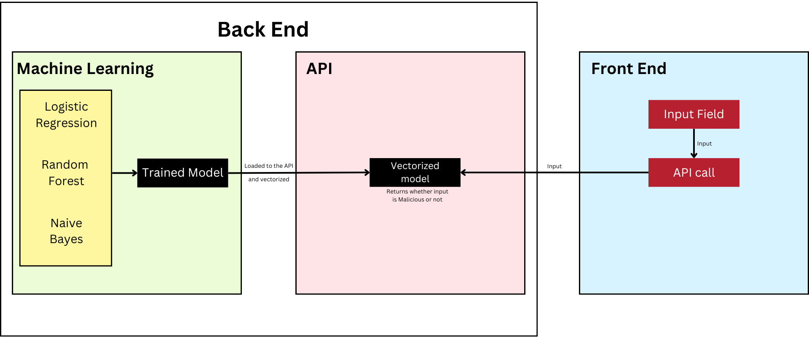
System Design

Slide 8
Model Performance
Sr no. | Model Name | Accuracy | Precision | Recall | F1 Score
1 | Logistic Regression | 0.943500 | 0.921838 | 0.969606 | 0.945119
2 | Random Forest | 0.976875 | 0.974473 | 0.97957 | 0.977016
3 | Naive Bayes | 0.897750 | 0.951668 | 0.838814 | 0.891684

Slide 9
API

Slide 10
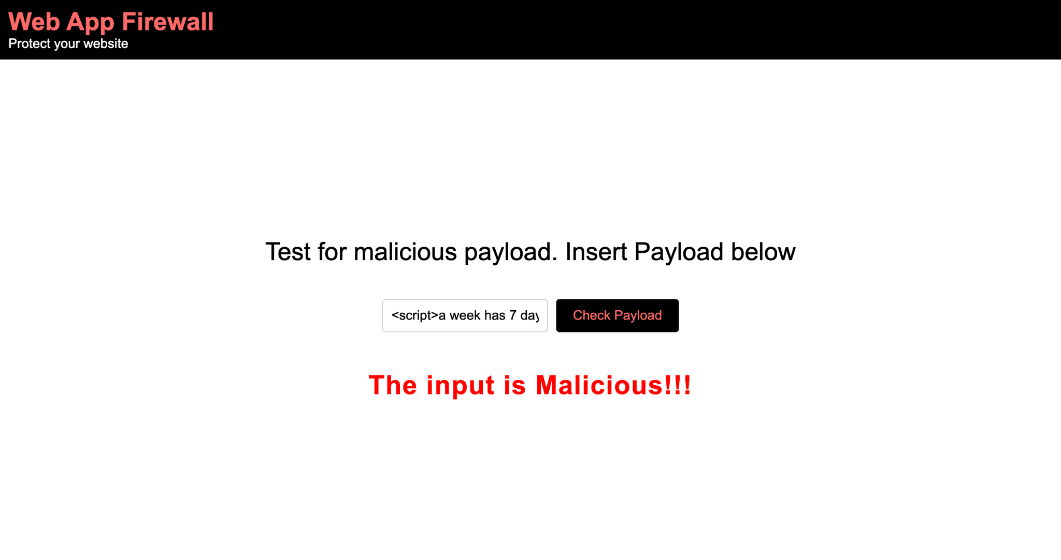
Implementation Screenshots: Cross Site Scripting

Slide 11

Implementation Screenshots: RFI

Slide 12

Implementation Screenshots: SSTI

Slide 13

Implementation Screenshots: Command Injection

Slide 14
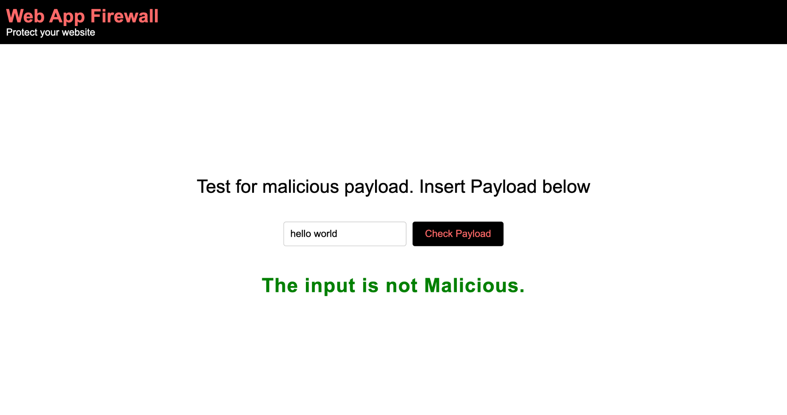
Implementation Screenshots: Non malicious input

Slide 15
Future Scope
Email notification
Upon detecting a malicious attack the api sends an email notification to the registered email address of the developer.
Attack prevention
Upon receiving a notification from the application the developer may take appropriate action to prevent the possible attack.

Slide 16
Summary
This project focuses on developing a Machine Learning-based Web Application Firewall (WAF), API designed to detect and mitigate common web threats like SQL Injection, Cross-Site Scripting (XSS), Command Injection, and Remote/Local File Inclusion (RFI/LFI). The WAF will analyze user inputs in forms, URLs, and HTTP requests, using machine learning to identify malicious patterns and potential attacks in real time. Front-end developers can easily integrate this API into their web applications to enhance security.

Slide 17
References:
https://www.researchgate.net/publication/361143640_Web_Application_Firewall_Using_Machine_Learning_and_Features_Engineering
https://www.researchgate.net/publication/329514915_Web_Application_Attacks_Detection_Using_Machine_Learning_Techniques

Slide 18
THANK YOU

